Slide 1


3D Visualization with ArcGIS API for JavaScript
Kristian Ekenes @kekenes
Raluca Nikola @nicolaraluk
2019 ESRI DEVELOPER SUMMIT
Palm Springs, CA
Notes:
In this session, you'll learn how to build applications with the ArcGIS API for JavaScript that utilize modern web development features. You'll learn how to build progressive web apps that meet the needs of your users, best practices, and how to use developer tools to measure your application performance and PWA standards.

Slide 2






Kristian Ekenes
Raluca Nicola
Product Engineer JS API
Product Engineer JS API
Data visualization, Smart Mapping, Arcade
Data visualization, 3D
Redlands, California
Zurich, Switzerland
Notes:
Not sure if this slide is worth it. We present ourselves anyway

Slide 3
Discover how to visualize geodata in a meaningful way in 3D using ArcGIS API for JavaScript
Notes:
Motivation – why are they here

Slide 4

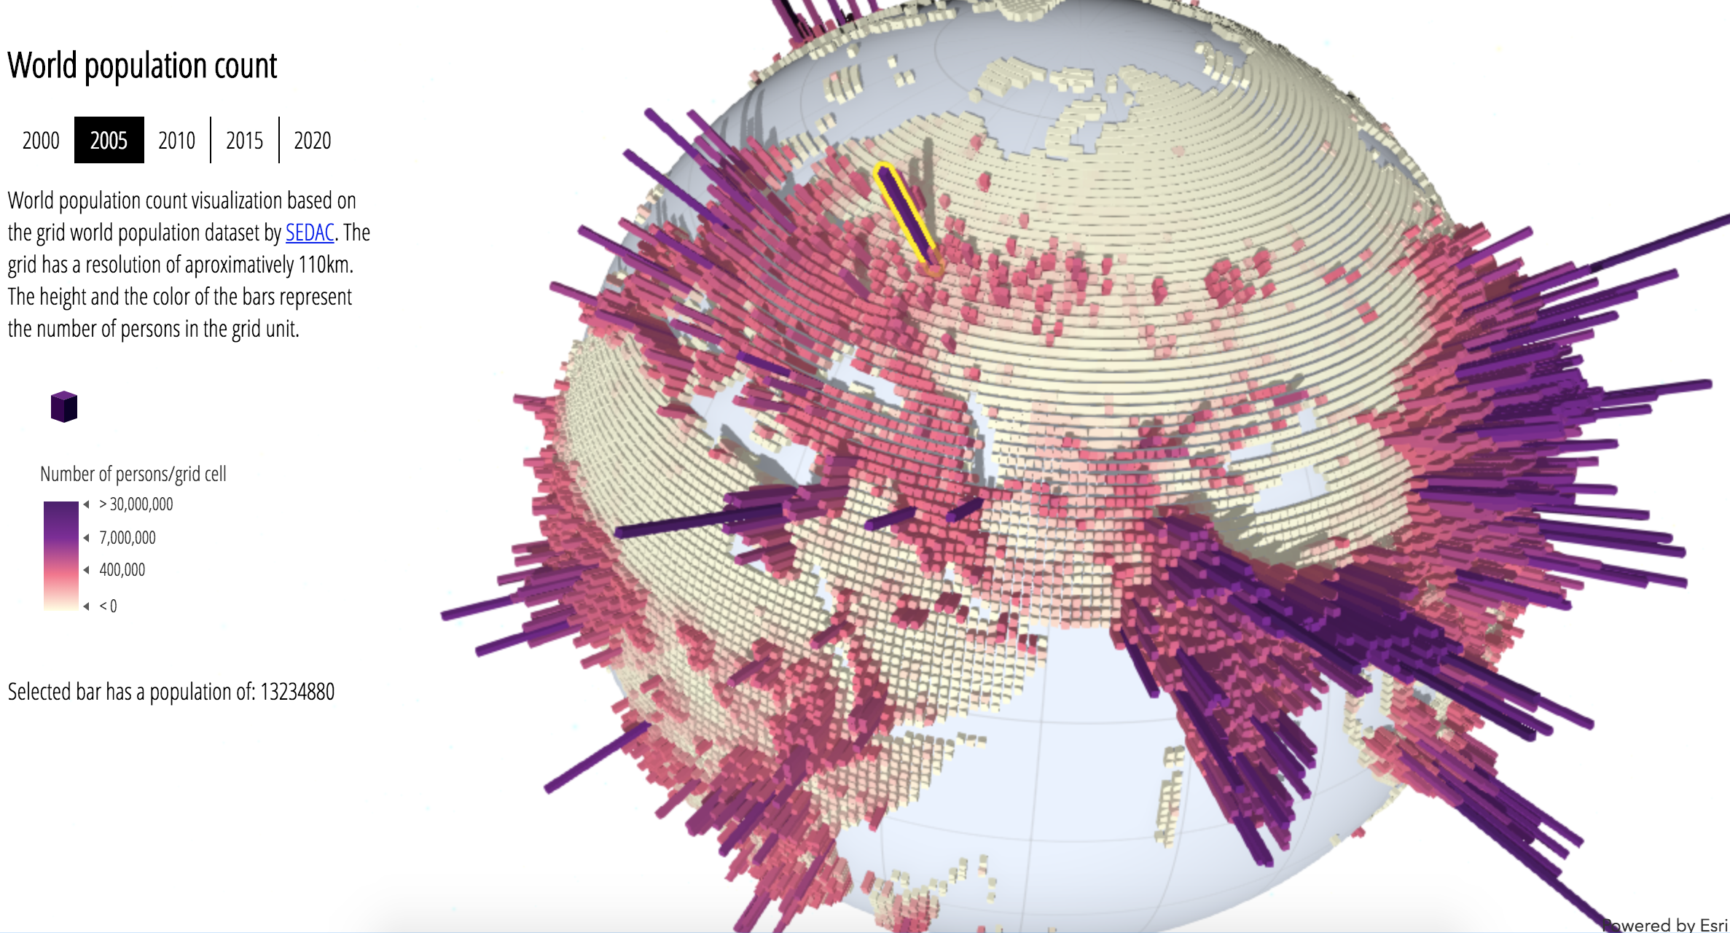
World population
Notes:
Intro – what we will show

Slide 5
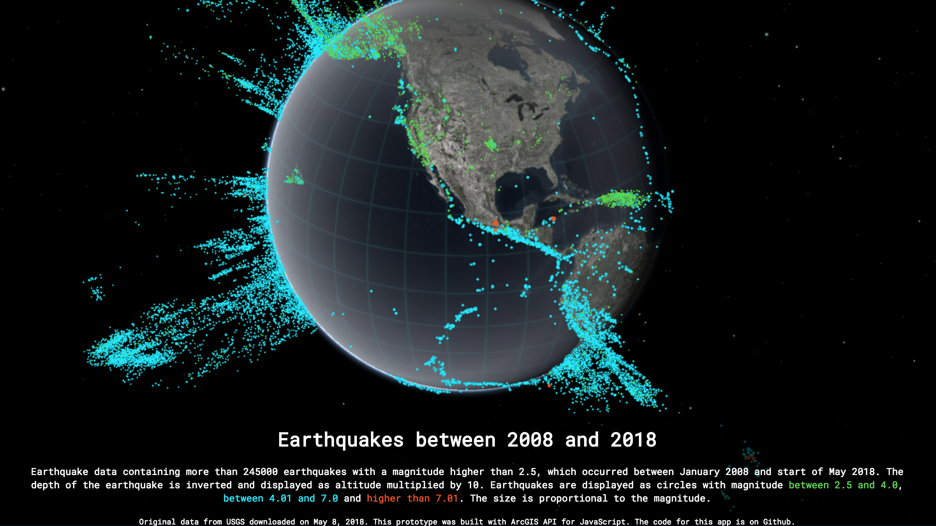
Earthquakes
Notes:
Intro – what we will show

Slide 6
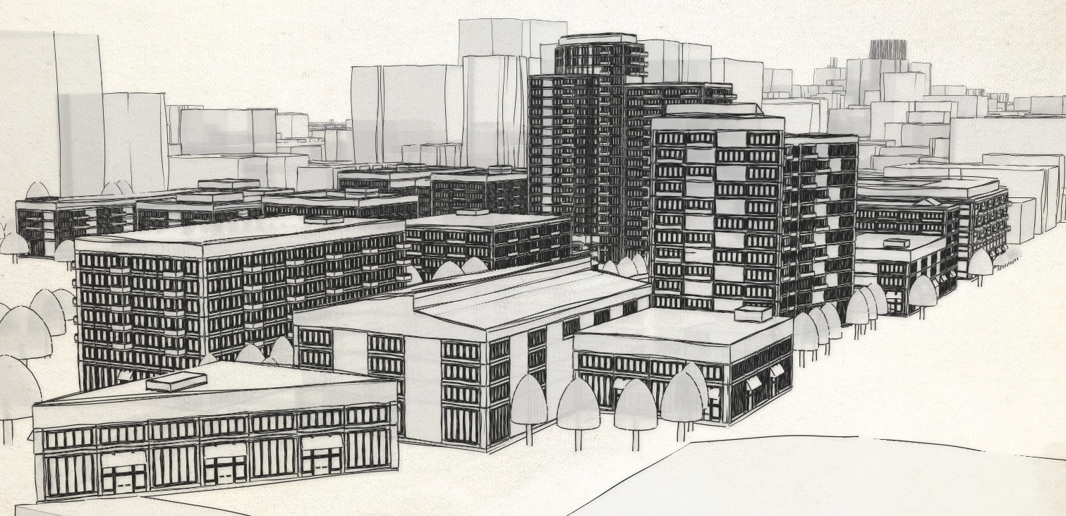
City sketches
Notes:
Intro – what we will show

Slide 7
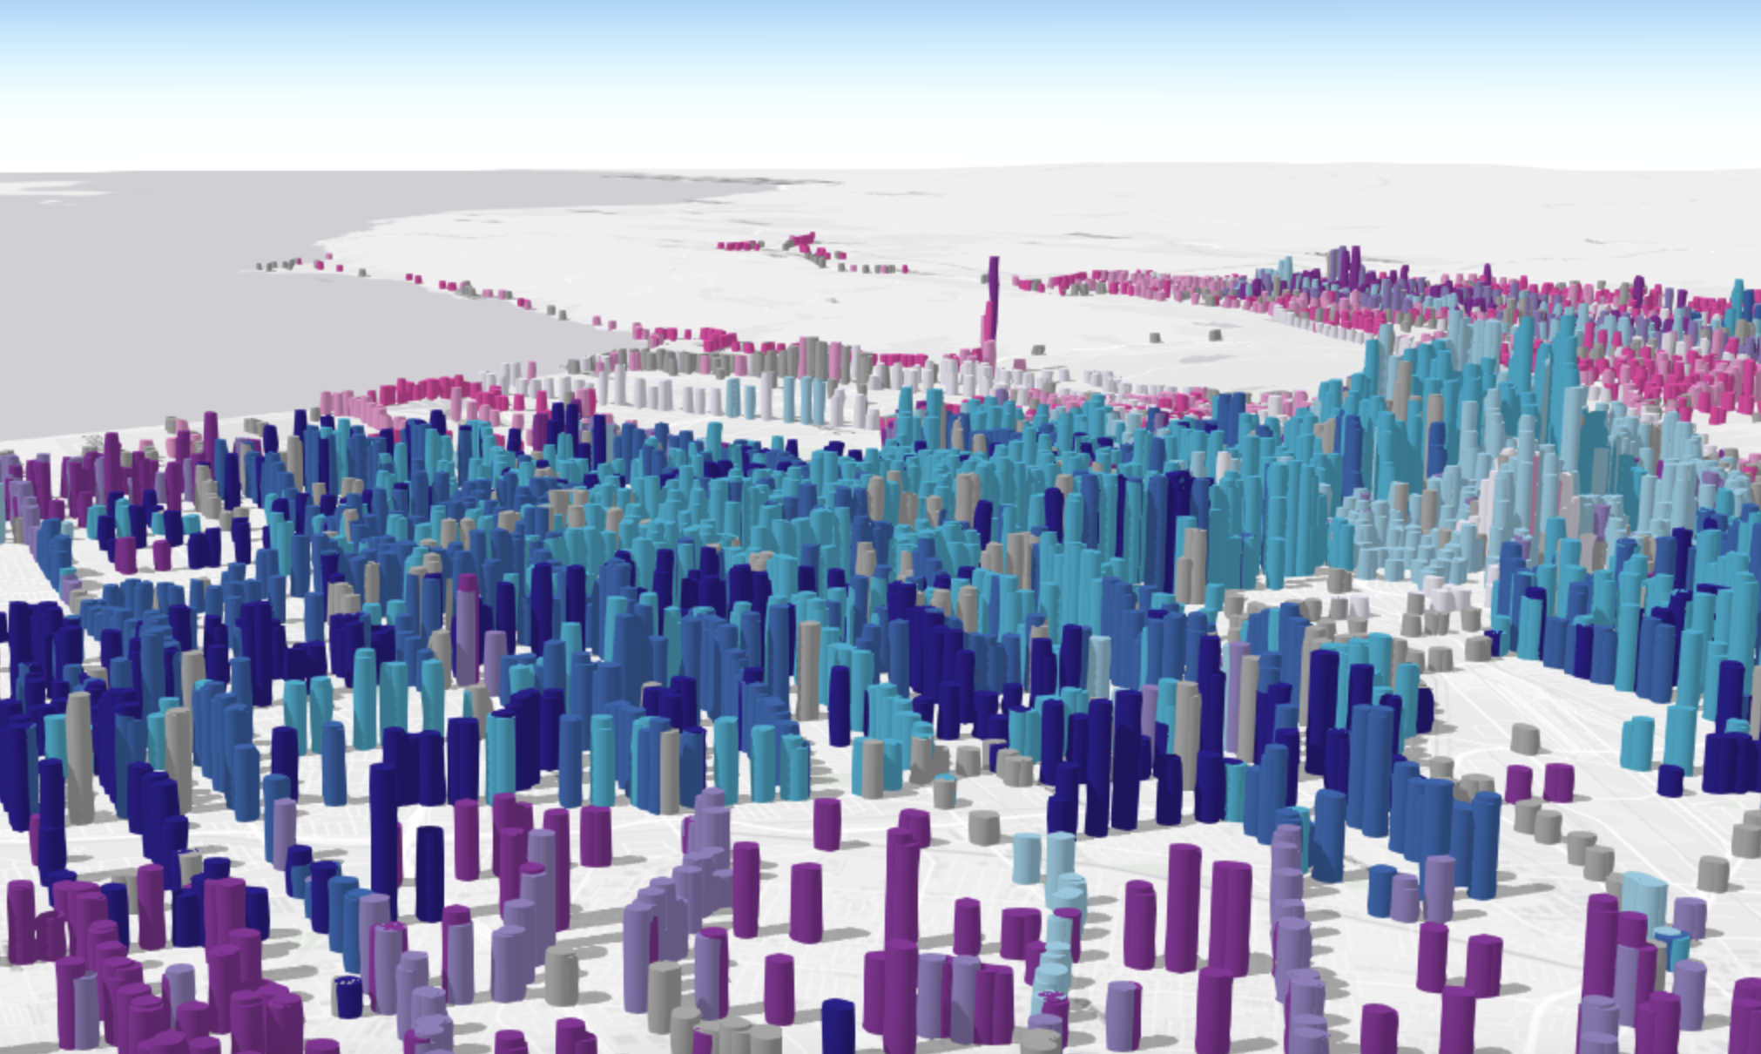
Smart mapping
Notes:
Intro – what we will show

Slide 8
Four use cases
- hands on demos -
Visualization API
- basics -
Symbols & renderers
- general overview -
5 min
25 min
10 min
Notes:
What’s the approach for learning how to visualize data

Slide 9
Symbols and Renderers
General overview

Slide 10
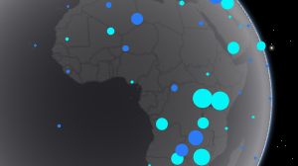
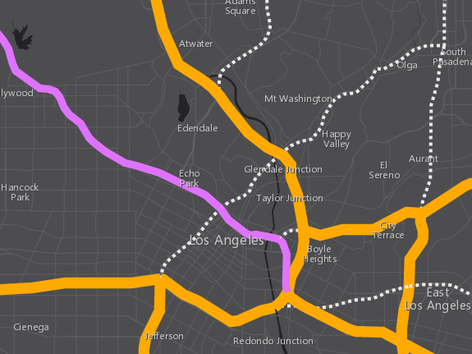
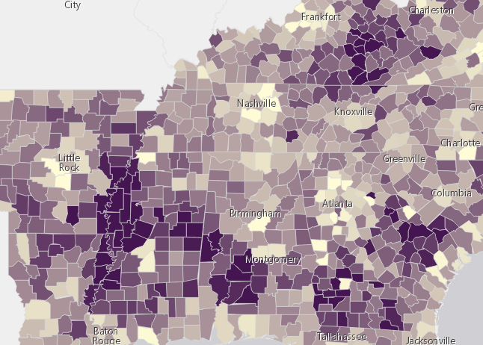
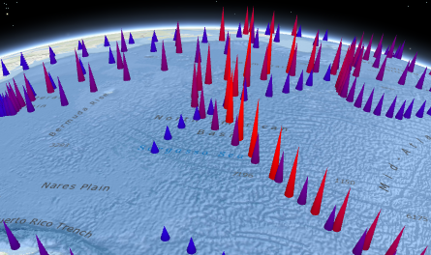
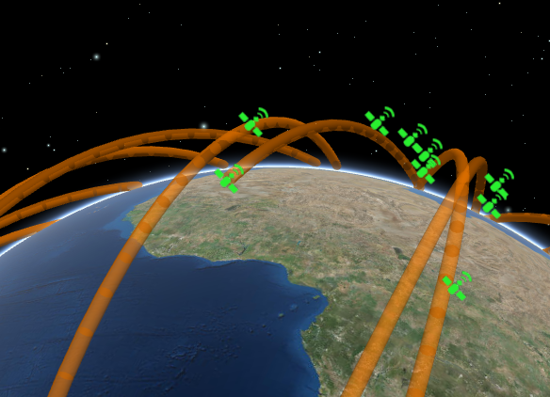
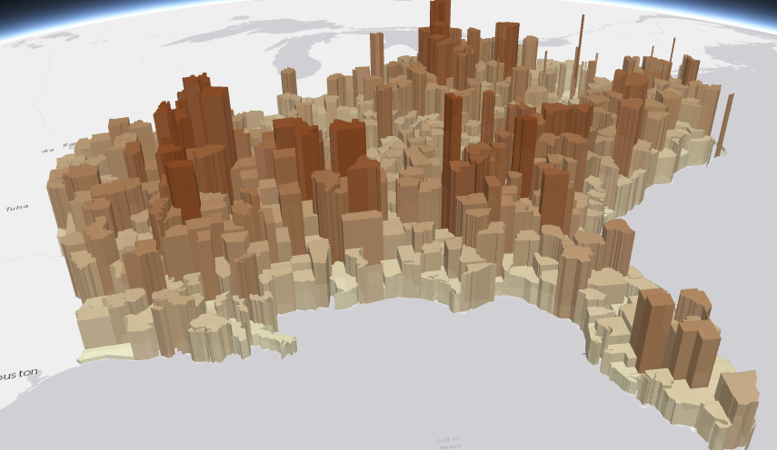
Symbols
PointSymbol3D
LineSymbol3D
PolygonSymbol3D
IconSymbol3DLayer
LineSymbol3DLayer
FillSymbol3DLayer
Flat
- Screen size units (pt, px)
- Graphics are in screen space
PathSymbol3DLayer
ExtrudeSymbol3DLayer
Volumetric
- Real world units (feet, meter)
- Graphics are in real world space
ObjectSymbol3DLayer

Slide 11
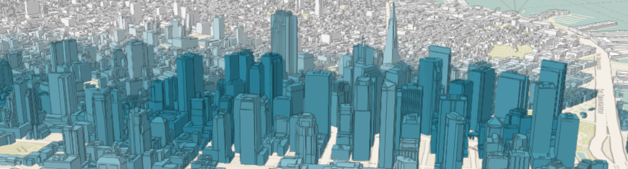
Symbols
MeshSymbol3D
FillSymbol3DLayer

Slide 12
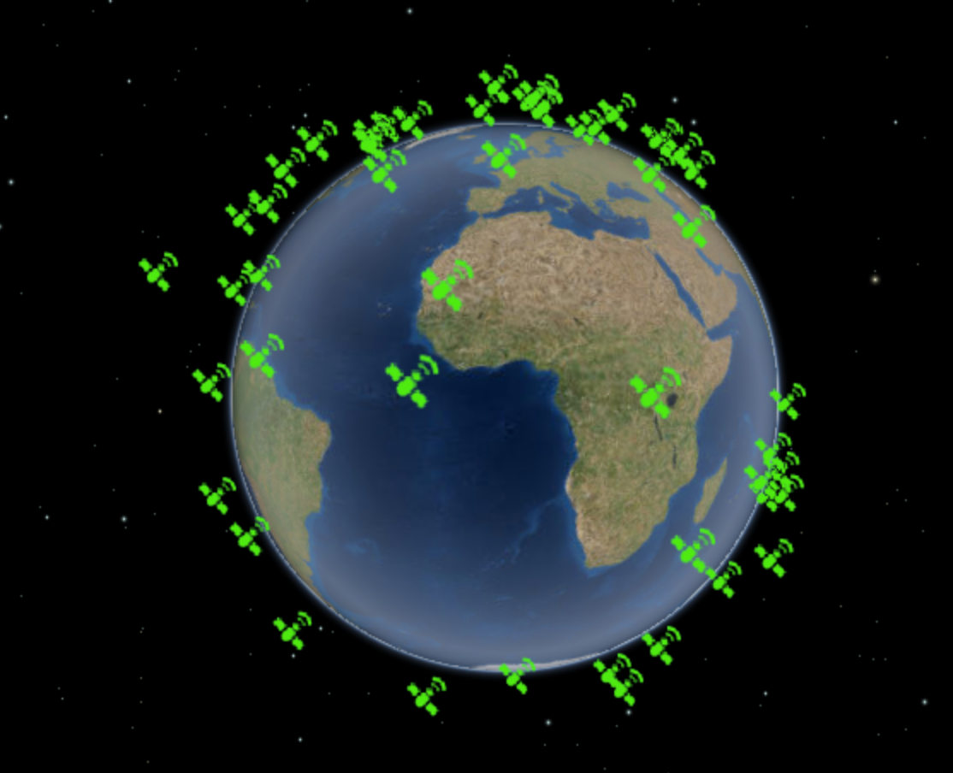
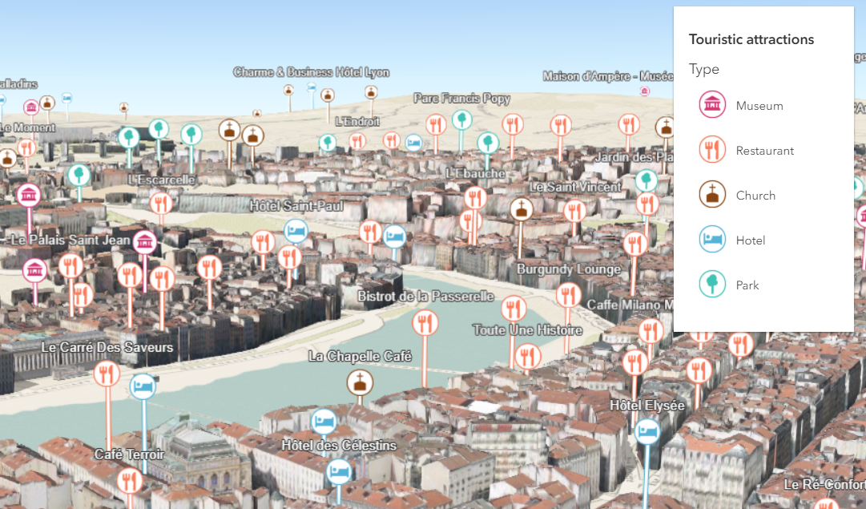
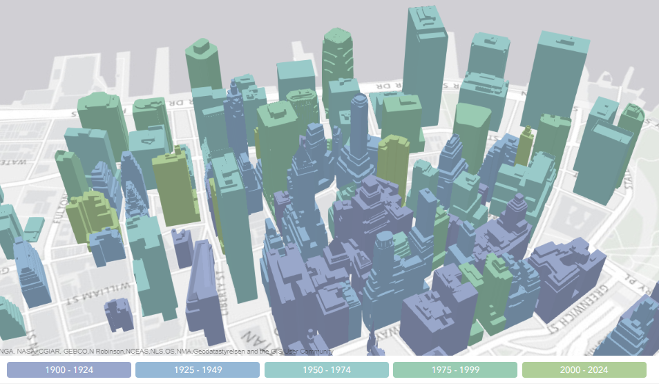
Renderers
SimpleRenderer
UniqueValueRenderer
ClassBreaksRenderer

Slide 13
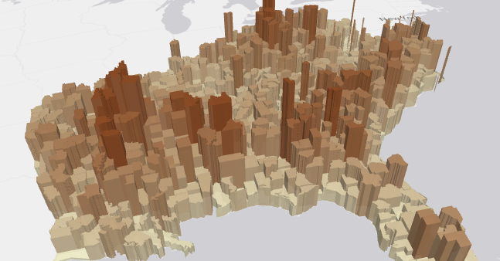
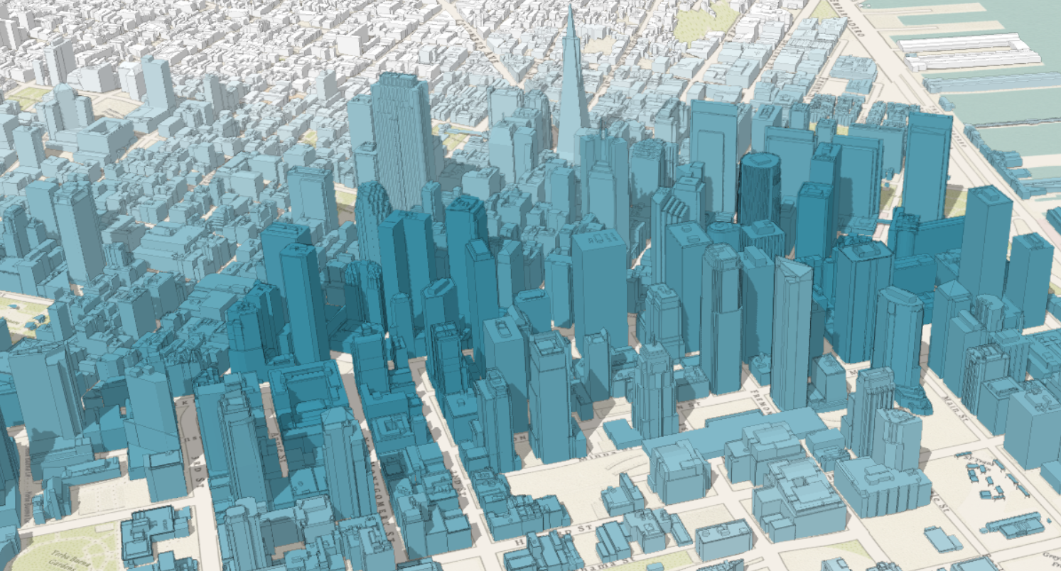
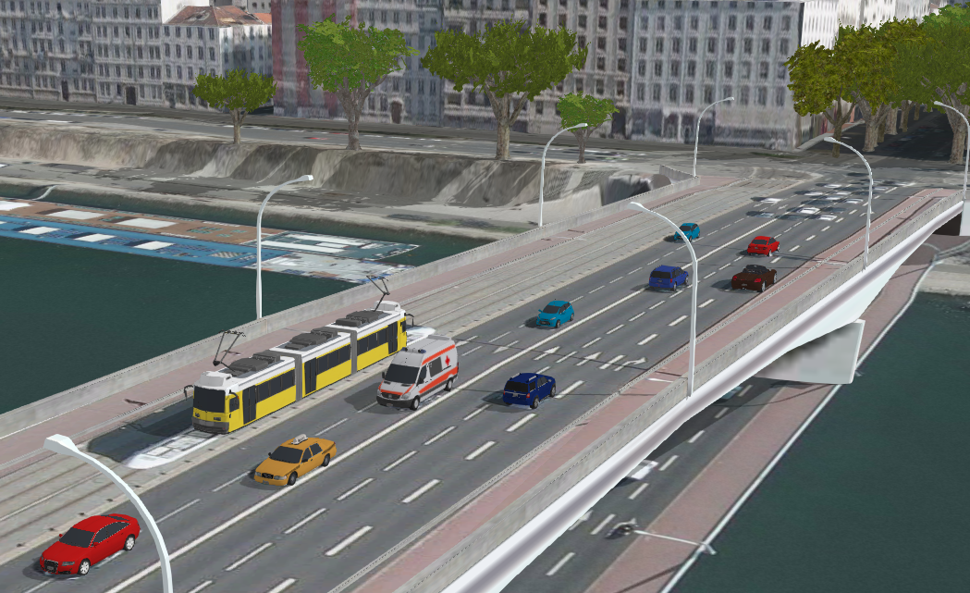
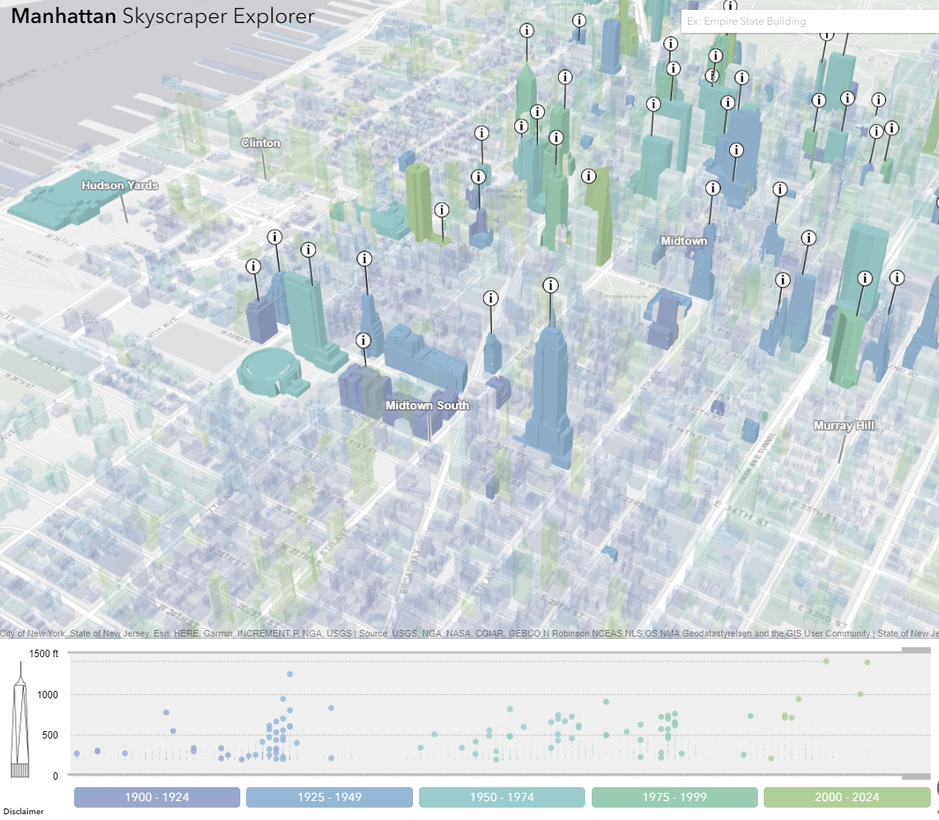
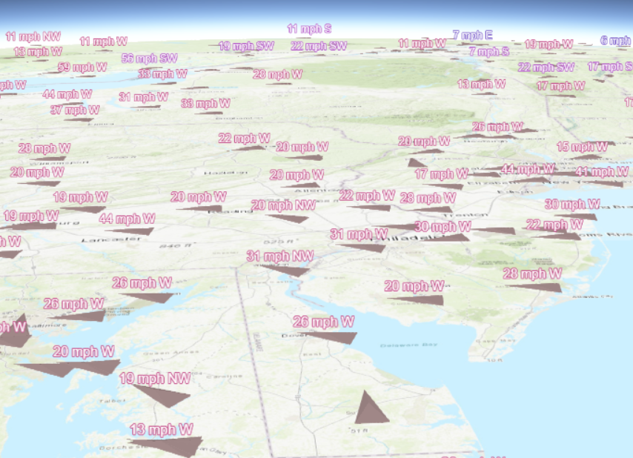
Multivariate mapping with visual variables
visualVariables - only for continuous numerical visualization
Color
Size
Rotation
Opacity

Slide 14
Visualization API
Basic patterns

Slide 15
layer
var layer = new FeatureLayer({
renderer: new SimpleRenderer({
symbol: new PointSymbol3D({
symbolLayers: [new IconSymbol3DLayer({…})]
})
}),
elevationInfo: {
mode: "relative-to-scene"
},
labelingInfo: [{
symbol: new LabelSymbol3D({
symbolLayers: [new TextSymbol3DLayer({…})]
})
}]
});
renderer
symbol
symbolLayers

Slide 16
var layer = new FeatureLayer({
renderer: new SimpleRenderer({
symbol: new PointSymbol3D({
symbolLayers: [new IconSymbol3DLayer({…})]
}),
visualVariables: [{
type: "size",
field: "TOTPOP_CY",
normalizationField: "SQMI",
stops: [{
value: 4000,
size: 6
},
{
value: 23000,
size: 40
}]
}]
});
renderer
symbol
symbolLayers
visualVariables
for numeric continuous visualizations

Slide 17
Data-driven visualization
Renderers & Visual Variables
Field value(s) TOTAL_POP
Arcade expression Round( ($feature.BACHELOR + $feature.MASTER) / $feature.POP_25UP) );

Slide 18
layer
var layer = new FeatureLayer({
renderer: new SimpleRenderer({
symbol: new PointSymbol3D({
symbolLayers: [new IconSymbol3DLayer({…})]
})
}),
elevationInfo: {
mode: "relative-to-scene"
},
labelingInfo: [{
symbol: new LabelSymbol3D({
symbolLayers: [new TextSymbol3DLayer({…})]
})
}]
});
elevationInfo
mode

Slide 19
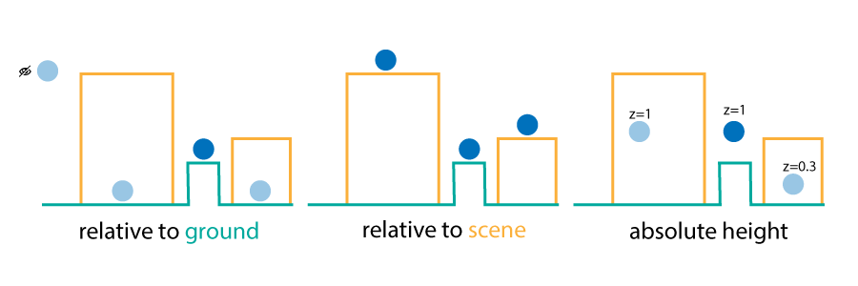
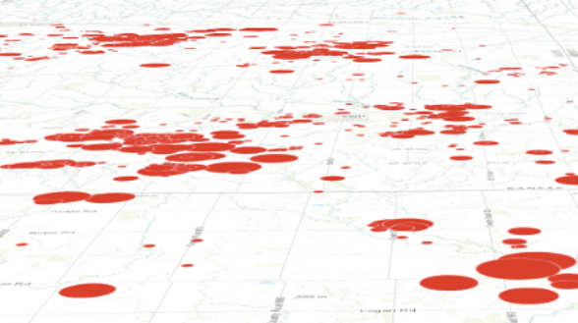
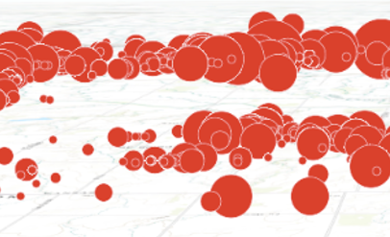
layer
elevationInfo
mode
on the ground
relative to ground

Slide 20
layer
var layer = new FeatureLayer({
renderer: new SimpleRenderer({
symbol: new PointSymbol3D({
symbolLayers: [new IconSymbol3DLayer({…})]
})
}),
elevationInfo: {
mode: "relative-to-scene"
},
labelingInfo: [{
symbol: new LabelSymbol3D({
symbolLayers: [new TextSymbol3DLayer({…})]
})
}]
});
labelingInfo
symbol
symbolLayers

Slide 21
Four use cases
Hands on demos

Slide 22

Visualization of the world population

Slide 23
Visualization of earthquakes

Slide 24
Visualization of cities as a hand-drawn sketch

Slide 25
Smart mapping

Slide 26
Resources
Visualization with ArcGIS API for Javascript overview - https://developers.arcgis.com/javascript/latest/guide/visualization-overview/index.html, https://developers.arcgis.com/javascript/latest/guide/creating-visualizations-manually/index.html
3D visualization techniques (series of 3 blogs) - https://www.esri.com/arcgis-blog/products/js-api-arcgis/3d-gis/3d-visualization-working-with-icons-lines-and-fill-symbols/
Visualize data on a globe - https://www.esri.com/arcgis-blog/products/js-api-arcgis/mapping/get-creative-with-globe-visualizations/
Sketch style for cities - https://www.esri.com/arcgis-blog/products/js-api-arcgis/mapping/sketch-your-city-with-arcgis-api-for-javascript/

Slide 28

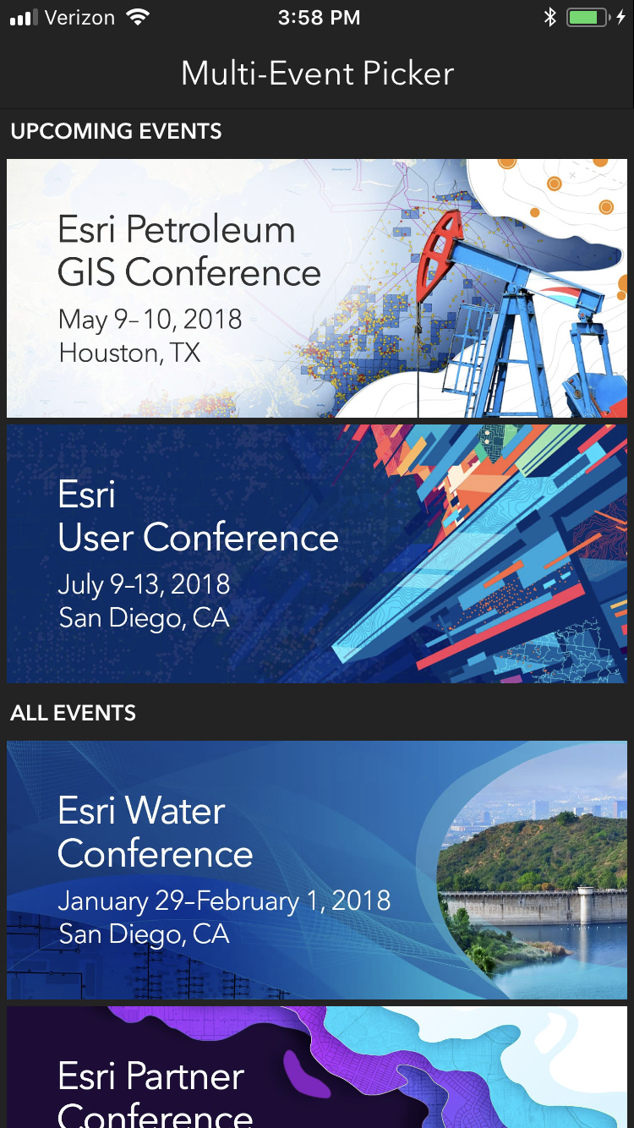
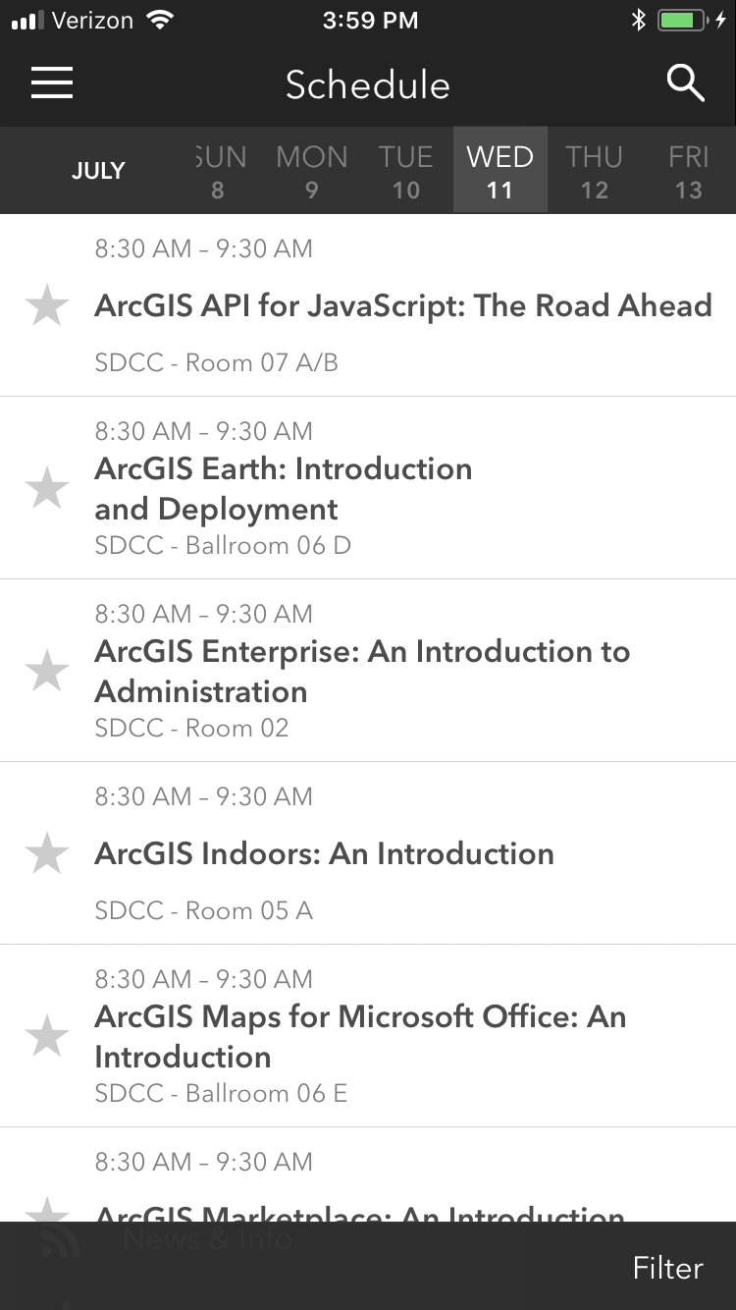
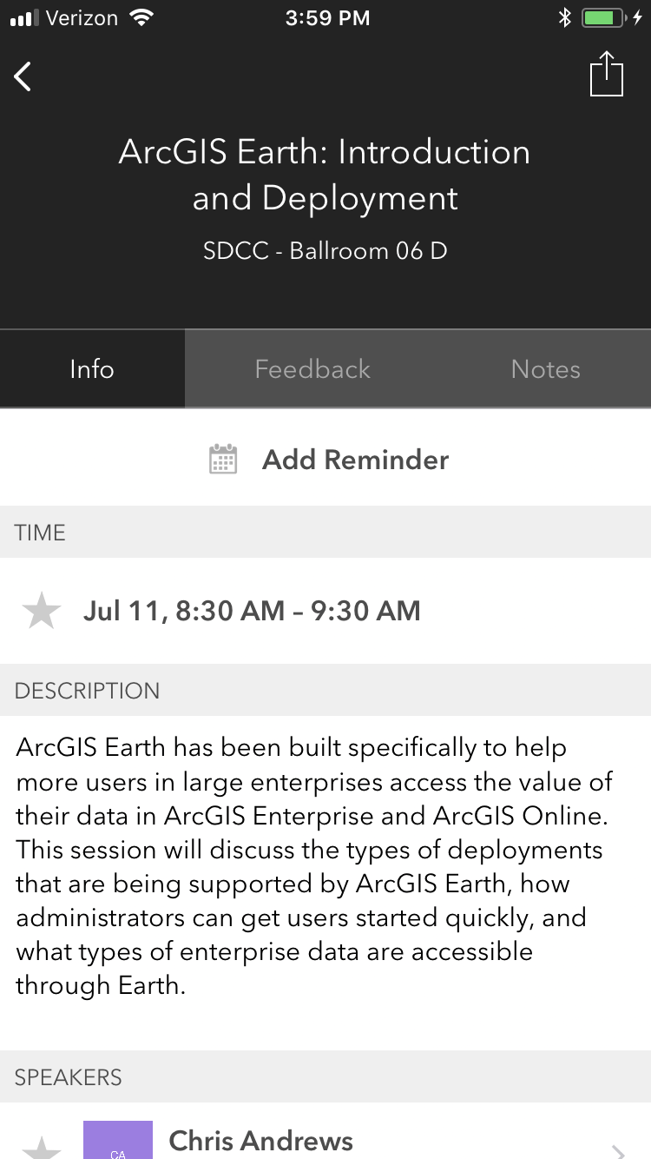
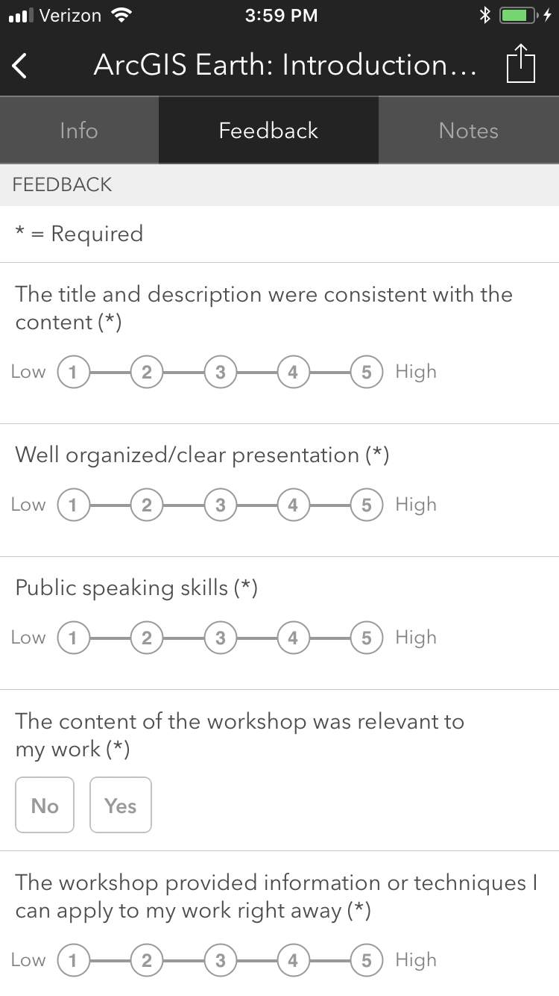
Please Take Our Survey on the App
Download the Esri Events app and find your event
Select the session you attended
Scroll down to find the feedback section
Complete answers
and select “Submit”

Slide 29
Presentation Title
Presenter Names
2019 ESRI DEVELOPER SUMMIT
Palm Springs, CA
Notes:
G243257 DevSummit 2019 Template for Esri staff

Slide 33
Click Here For DEMO
Sample Name Here

Slide 35
Please Take Our Survey on the App
Download the Esri Events app and find your event
Select the session you attended
Scroll down to find the feedback section
Complete answers
and select “Submit”

